Slide 1
Lecture 15
Model Driven Engineering
  MDE, MDSE, MDD, MDT…
BSSE (Software Engineering-I) SZABIST-Islamabad

Slide 2
What is MDE
Model-Driven Engineering (or MDE) refers to the systematic use of models as primary engineering artifacts throughout the engineering lifecycle.
Models are considered as primary artifacts from which parts of a software system can be automatically generated.
MDE can be applied to software, system, and data engineering. Use of MDE approaches in Software Engineering is called MDSE. Various terms and approaches to MDSE.
  Model-Driven Architecture (MDA)
  Model-Driven Development (MDD)
  Model-Driven Testing (MDT)

Slide 3
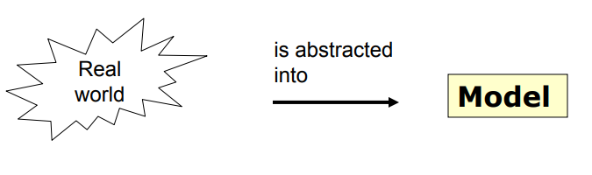
What is a Model?
“A model is an abstraction of something for the purpose of understanding it before building it”
Models are widely used in engineering disciplines

Slide 4
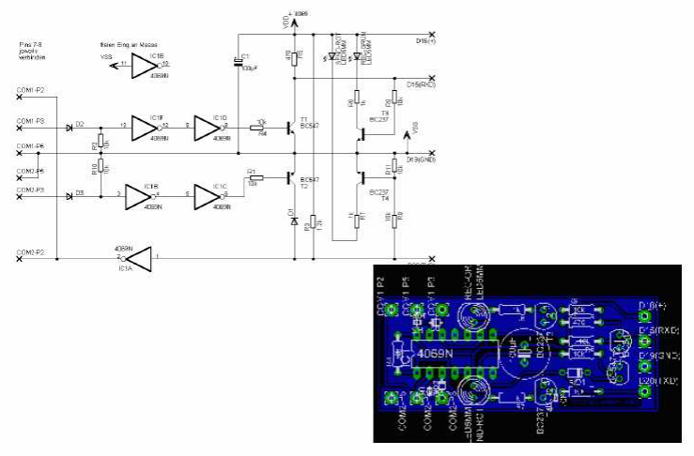
Examples of Models in Electrical Engineering

Slide 5
Important Properties of Models
Abstraction from certain aspects of the real world.
Focus on certain aspects of the real world _x0001_
Ability to analyze properties of the system using the model _x0001_
Models are usually expressed in a modeling language with a well-defined syntax and semantics _x0001_
Many different forms of analysis, depending on the model and the application of modeling

Slide 6
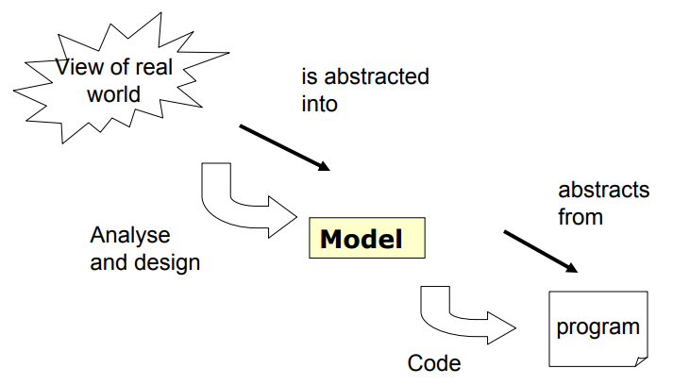
Models in Software Engineering
Different kinds of models are used in software engineering
  Models for requirements analysis
  Models for expressing the software architecture of a system

Slide 7
Usage of Models in Software Engineering
Models as description of the domain of the system to be built
  Model focuses on relevant aspects of the domain
  Example: Class diagram of the domain _x0001_
Models as abstract representation usage of the system to be built
  Model focuses on aspects that are relevant, leaves other aspects open
  Example: Usecase diagram specifies actor and function they performing in a system to be built _x0001_
Models for documentation
  Abstraction of models helps to understand the system faster
  Example: Class diagram of the key entities in a system are explained in a document _x0001_
Models as specification for testing
  Model focuses on important aspects of the system for testing

Slide 8
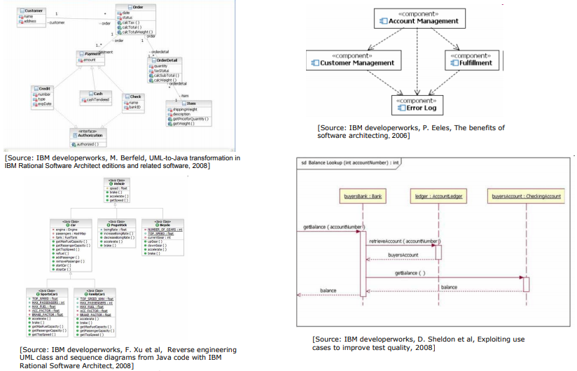
Sample Models from Software Engineering
BSSE (Software Engineering-I) SZABIST-Islamabad

Slide 9
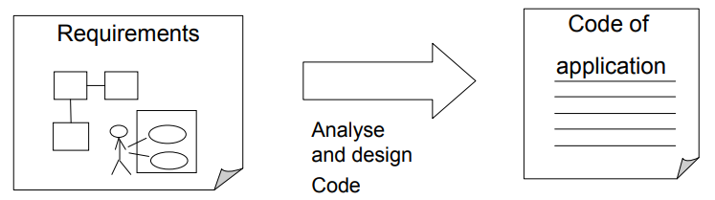
Concepts of Model-Driven Software Development
Model-driven development (MDD) leverages graphical models and pre-built application components so that users can visually construct complex applications. e.g Adobe Dreamweaver
How to get from requirements to running code satisfying requirements and user expectations? _x0001_
Models are used in many development processes
  –requirements for the system (e.g. use case model)
  –software architecture (e.g. component model)
  –behavioral description (e.g. statechart)

Slide 10
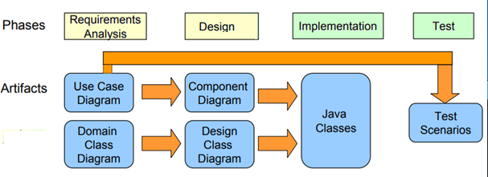
Usages of Models and Model Transformations in MDSE - Example
In each phase, different models are constructed _x0001_
In each phase, we reuse parts of models as input for other models
  Test scenarios are partially derived from Use Case Diagrams
  Design Class Diagram may reuse parts of Domain Class Diagram
MDSE focuses on automatically generating parts of models or code from other models

Slide 11
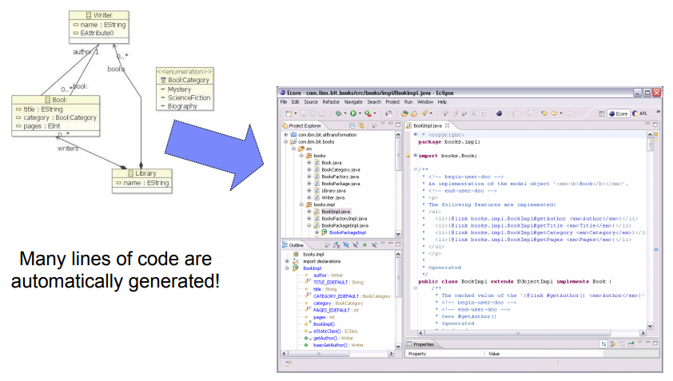
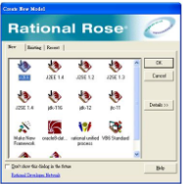
Eclipse Modeling Framework as an Example

Slide 12
Advantages of MDSE
Abstraction from specific realization technologies
  – Improved portability of software to new/changing technologies
  – model once, build everywhere
  – Interoperability between different technologies can be automated
  – Requires modeling languages, which do not hold specific concepts of realization technologies (e.g., Java EJB) _x0001_
Automated code generation from abstract models
  – e.g., generation of Java-APIs, XML Schemas, etc. from UML
  – Requires expressive und precise models
  – Increased productivity and efficiency (models stay up-to-date) _x0001_
Separate development of application and infrastructure
  – Separation of application-code and infrastructure-code (e.g. Application Framework) increases reusability
  – Flexible development cycles as well as different development roles possible
Promoting communication between individuals and teams working on the system (via a standardization of the terminology and the best practices used in the application domain).

Slide 13
Unified Modeling Language (UML)
A standardized, graphical “modeling language” for communicating software design.
Allows implementation-independent specification of:
  user/system interactions (required behaviors)
  partitioning of responsibility (OO)
  integration with larger or existing systems
  data flow and dependency
  operation orderings (algorithms)
  concurrent operations
Pretty pictures.
UML is not “process”. (That is, it doesn’t tell you how to do things, only what you should do.)

Slide 14
Types of UML Diagrams
There are different types of UML diagram, each with slightly different syntax rules:
  use cases.
  class diagrams.
  sequence diagrams.
  package diagrams.
  state diagrams
  activity diagrams
  deployment diagrams.

Slide 15
UML Syntax
Actors: a UML actor indicates an interface (point of interaction) with the system.
  We use actors to group and name sets of system interactions.
  Actors may be people, or other systems.
  An actor is NOT part of the system you are modeling. An actor is something external that your system has to deal with.
Boxes: boxes are used variously throughout UML to indicate discrete elements, groupings and containment.

Slide 16
UML Syntax
Arrows: arrows indicate all manner of things, depending on which particular type of UML diagram they’re in. Usually, arrows indicate flow, dependency, association or generalization.
Cardinality: applied to arrows, cardinalities show relative numerical relationships between elements in a model: 1 to 1, 1 to many, etc.

Slide 17
UML Syntax
Constraints: allow notation of arbitrary constraints on model elements. Used, for example, to constrain the value of a class attribute (a piece of data).
Stereotypes: allow us to extend the semantics of UML with English. A stereotype is usually a word or short phrase that describes what a diagram element does. That is, we mark an element with a word that will remind us of a common (stereotypical) role for that sort of thing. Stereotypes should always be applied consistently (with the same intended meaning in all instances).
Graphically, a stereotype is rendered as a name enclosed by (« »).

